Slide 1
Daily Review
CFU 1
True or False: Electrostatic charge is caused by the movement of protons.
Electrostatic Charge
Electric charge is either positive or negative.
Electrons – negative
Protons – positive
Usually objects are uncharged, but when electrons move from one object to another (e.g. by rubbing together) it create:
An area of relatively positive charge (has lost electrons)
An area of relatively negative charge (has gained electrons)
We call this difference in charge – Electrostatic Charge
CFU 2
If an object gains electrons, will it be coming negatively charged, or positively charged?

Slide 2
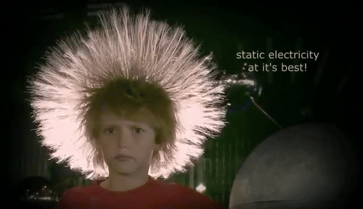
Daily Review
CFU 1
True or False: Electrons are attracted to each other.
Electrostatic Charge
When charged particles are near each other they apply an electrostatic force on each other.
Like charges repel
E.g. 2 positive particles push away from each other
Unlike charges attract
E.g. a positive particle and a negative pull towards each other
CFU 2
Explain why the boy’s hair is standing on end and spreading out.

Slide 3

Daily Review
CFU 1
Which two objects are interacting?
Explaining Electrostatic Charge
State the two objects that are interacting. State which object is gaining electrons. State the relative charge of each object.
CFU 2
Which object is gaining electrons?
After bouncing on the trampoline for a while your hair starts to stand on end. You are gaining electrons from the trampoline mat through your feet.
CFU 2
What are the relative charges of the objects?
The ____ and the _____ are exchanging electrons. The electrons are moving from the _____ to the ______.
The ______ is now relatively negative, and the _____ is relatively positive.
CFU 2
Think-pair-share: why are the strands of hair spreading out from each other?

Slide 4
Circuit Diagrams Year 9 Physics

Slide 5

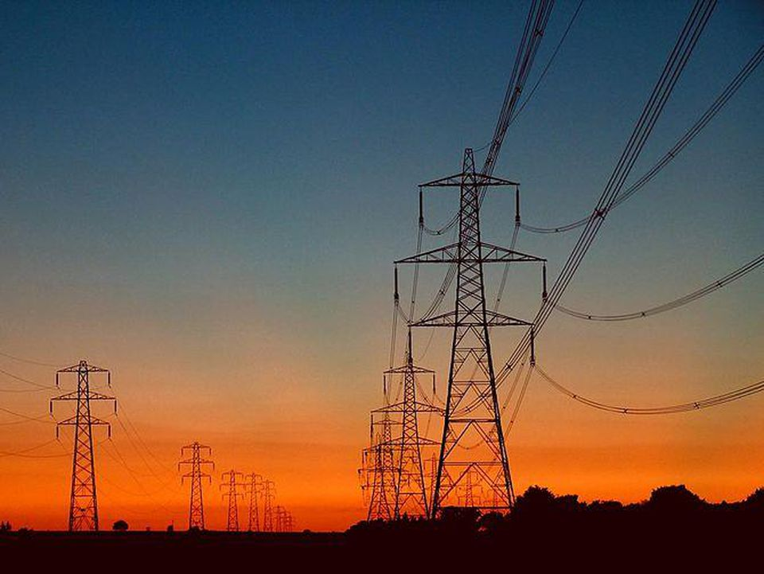
Learning Objectives
CFU
In your own words: what are we going to learn?
Describe how charge flows through an electric circuit
Identify the components of an electrical circuit
Draw basic circuit diagram components
Activate Prior Knowledge
Electrical circuits are all around us.
Think-pair-share:
Where have you seen electrical circuits around you?
How are they similar?
How are they different?

Slide 6
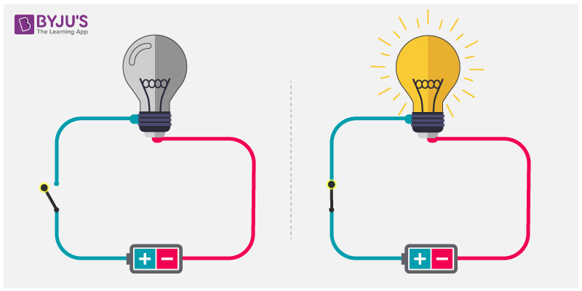
Concept Development
CFU 1
List the 3 essential components of all electric circuits.
Electric Circuits
A pathway travelled by electrical energy
Circuits can vary from very complex (e.g. in your phone) to very simple (e.g. in a torch)
However, all circuits have 3 essential components
A power source
A pathway
A load
We typically also put a switch into our
circuits, to allow us to control when they
are open and closed
CFU 2
Describe a switch, and explain why it is useful in a circuit.

Slide 7
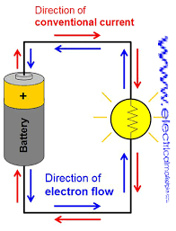
Concept Development
CFU 1
True or False: electric current is created by moving electrons when a circuit is open.
Moving Charge
When an electric circuit is closed an electric current is created by the movement of electrons (charge).
The electrons move from the negative terminal of a battery, through the circuit, to the positive terminal.
Note: although we now know that electrons cause the current, that was not always the case.
In the past it was thought that the charge moved from positive to negative, we call this conventional current
This conventional current is in the opposite direction to the flow of electrons
CFU 2
Explain how conventional current different to electron flow?

Slide 8
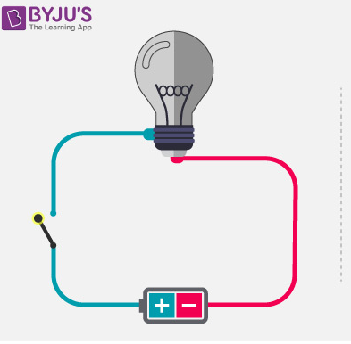
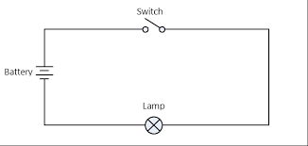
Concept Development
CFU 1
Were you paying attention? In which direction do electrons flow in an electric circuit?
Circuit Diagrams
Circuits are represented using circuit diagrams
Circuit diagrams use basic symbols to represent components in an electric circuit
This means that circuit diagrams can be read and interpreted by anybody who knows the basic symbols
Note: There are some slight variations that you might see in the symbols, but they are mostly the same
CFU 2
Think-pair-share: Why is it useful to use simple, common symbols in circuit diagrams?

Slide 9
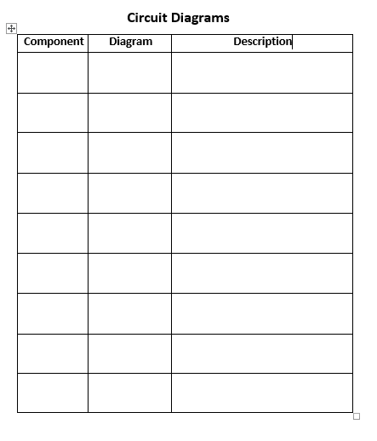
Guided Practice
Collect a paper copy of the Circuit Diagrams worksheet and fill in the boxes as we work through the following slides.

Slide 10
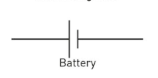
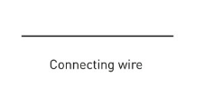
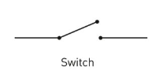
Guided Practice
Battery
The power source of a circuit
Drawn as 2 straight lines, one long and one short
The long line is the positive terminal
The short line is the negative terminal
Connecting wire
Conduct electricity through the circuit
Shown as straight lines (usually)
Join with other wires at right angles (usually)
Switch
Switch to control when the circuit is closed or open
Can be drawn in the open or closed position

Slide 11
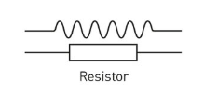
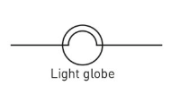
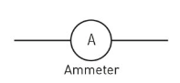
Guided Practice
Resistor
A component in a circuit that limits the flow of charge
Either drawn as an empty rectangle, or a squiggly line
Light globe
A thin piece of wire in a glass casing
When the wire gets hot, it glows and emits light
Converts electrical energy to light energy
Can also be drawn as a resistor in a circle of a cross in a circle
Ammeter
Gauge to measure how fast the charge is flowing through a circuit
Measures current

Slide 12
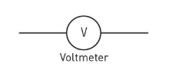
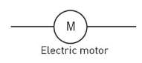
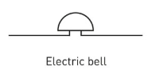
Guided Practice
Voltmeter
A gauge to measure how hard the charge is being pushed through a circuit
Measures voltage
Electric motor
A motor that is powered by an electric current
Electric bell
A bell that sounds when it has electric current flowing through it

Slide 13
Relevance
Electric circuits are all around you.
Some of you may work in a field that involves electric circuits
Electrician
Engineer
Technology
Car auto electrician/mechanic
Electric equipment is becoming increasingly common, and being included in many items that have previously been analogue

Slide 14
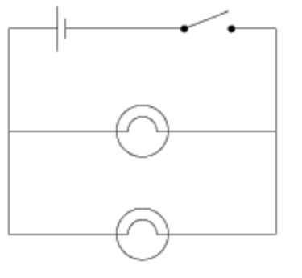
Skill Closure
List the 3 essential components of an electric circuit
Draw these components as they would be shown in an electric circuit
Describe what role they play in the electric circuit
Skill Closure
In the circuit diagram to the right, identify all of the components and describe their function in a circuit.
Skill Closure
Challenging Yourself: Explain the difference between electron flow, and conventional current in an electric circuit.

